Slide 1
Lesson objective
PBiS Focus: Achieve
Understand the lesson objective
Title: Geometric reasoning
Aim:
Be able to use geometric reasoning to solve questions with triangles, straight lines and vertically opposite angles.
Plan:
Daily review: VO angles
Exploring concepts
Practice
Whiteboards and calculators

Slide 2
Choral response
Complementary angles add up to $90°$
Supplementary angles add up to $180°$

Slide 3
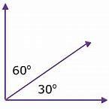
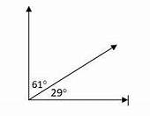
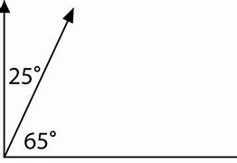
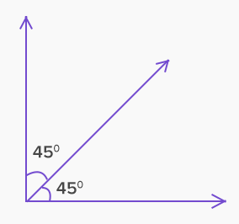
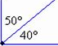
Complementary Angles add up to 90º
Which is not a pair of complementary angles?
x
31º
60º
??

Slide 4
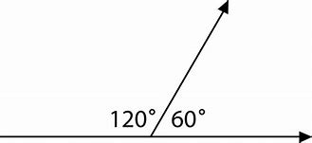
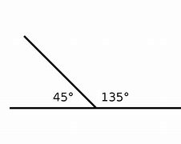

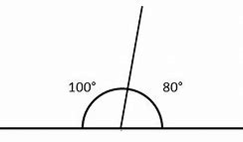
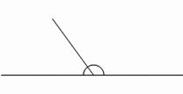

Supplementary Angles add up to 180º
^{Which is not supplementary?}
x
40º
140º
100º
??
81º

Slide 5
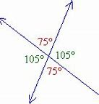
Vertically Opposite angles are Equal
140º
152º
40º
40º
28º
28º
140º
152º
x
150º
120º
30º
30º
60º
59º
150º
121º

Slide 6
Daily review
Complementary angles add up to ______
Supplementary angles add up to _______
Vertically opposite angles are e_______
How many degrees in a straight line?
How many degrees in a triangle?

Slide 7
Individual practice
“find the complement to…”
“Find the supplement to…”

Slide 8
Whiteboards
supplementary angles add up to 180$°$
Write an equation and solve the unknown angle.
X + 45 + 55 = 180
X + 100 = 180
55$°$
45$°$
x$°$

Slide 9
Whiteboards
supplementary angles add up to 180$°$
Write an equation and solve the unknown angle.
x$°$
x$°$
x$°$

Slide 10


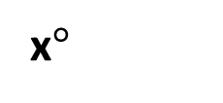
Whiteboards
Solve the missing angle.
X + 80 + 50 = 180
80$°$
X + 130 = 180
50$°$
x$°$

Slide 11


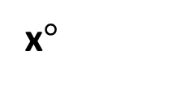
Whiteboards
Solve the missing angle.
X + 65 + 90 = 180
x$°$
X + 155 = 180
65$°$
90$°$

Slide 12
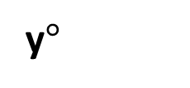
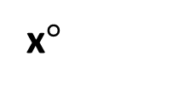
Whiteboards
Solve the missing angle.
Y + 80 + 50 = 180
80$°$
Y + 130 = 180
50$°$
y$°$
x$°$

Slide 13





What is going to have the same angles?
Matching colours are equal because they are……..
What should 1 red and 1 yellow equal if together they form a straight line?
1 orange and 1 green?
1 black and 1 blue?
What will 1 red, plus 1 green and 1 blue equal? Why?

Slide 14


Solving missing angles
50$°$
$$60°$$

Slide 15


We try
Draw the triangle with extra lines. We will be using this often, so don’t BIN the triangle.
60$°$
70$°$

Slide 16


Whiteboards: you try
45$°$
60$°$

Slide 17


Whiteboards: you try
65$°$
70$°$

Slide 18
Whiteboards: you try
What do we know?
This is the geometric reasoning part.
4
6
5
1
7
2
3
10
8
9
11
12

Slide 19
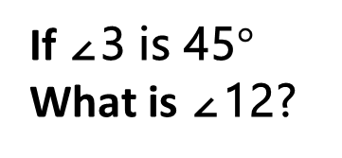
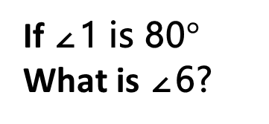
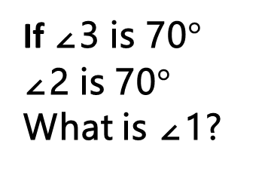
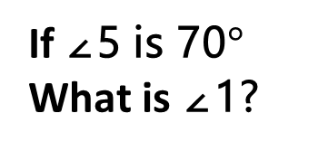
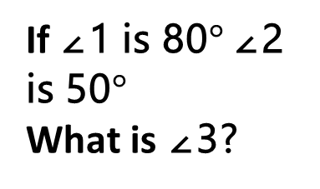
Whiteboards: you try
If ∠5 is 70$°$
What is ∠1?
If ∠1 is 80$°$
What is ∠6?
4
6
5
1
If ∠3 is 70$°$
∠2 is 70$°$
What is ∠1?
If ∠3 is 45$°$
What is ∠12?
If ∠1 is 80$°$ ∠2 is 50$°$
What is ∠3?
7
2
3
10
8
9
11
12

Slide 20
Individual practice
“who’s who?”
“what is the definition of a mermaid?”

